Slide 1

Трећа недеља среда
Tамара Павловић BCS 2023

Slide 2
Циљеви за данас
Разумети улогу падежа у БЦС-у
Разумети употребу номинатива и акузатива

Slide 3
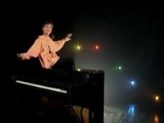
Tekst https://tekstovi.net/2,2301,31388.html

Slide 4
Зашто падежи
Dog sees a cat Pas vidi mačku.
A cat sees dog Mačku vidi pas.
Sees dog a cat Vidi pas mačku.
Sees cat a dog Vidi mačku pas.
SVO – Subject verb object
Subject vs predicate

Slide 5
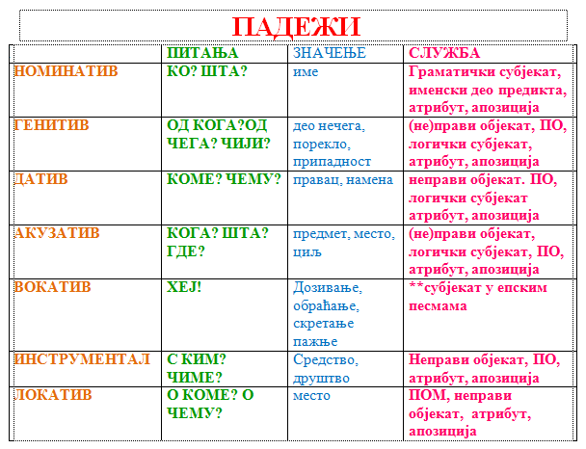
Које падеже имамо

Slide 6




Zorica Junior
Prvi padež, ko-šta jednog dečka volim ja drugi padež, koga-čega nikog drugog osim njega Treći padež, kome-čemu on meni, a ja njemu a četvrti, šta-il' koga on je deo srca moga
nominativ
genitiv
dativ
akzativ

Slide 7
Usage and Function
Nominative comes from Latin cāsus nominātīvus "case for naming"
Always the subject of the sentence (the one who performs an action)
Dictionary form (basic form)
Predicate noun or adjective. The purpose of the predicate is to modify the subject
The nominative also marks things equal to the subject (that is, a predicate noun or adjective).
Socrates was a wise man.
Socrates was wise.
Marko je dobar drug/prijatelj.
Marko je dobar drug/prijatelj. (predicate function)

Slide 8
Usage and Function
Ovo je knjiga. (naming things)
Ovo je knjiga.
Follows certain verbs : biti (to be), postati (to become), zvati se (to be called)
On je bio kralj.
On je postao kralj.
On se zove Ričard Treći.

Slide 9
Usage and Function
The accusative case in BCS functions as DIRECT OBJECT which is one of its most important functions when used without prepositions.
Object in a sentence is defined as the entity that is acted upon by the subject.
Marko voli Anu.
Marko-subject, voli-predicate, Anu direct object (accusative case of Ana)

Slide 10
Usage and Function
Only transitive verbs can have direct objects! Transitive verb is a verb that requires both a subject and one or more objects. In grammar, an intransitive verb is a verb that has no direct object (reflexive (“se” verbs, like in sećati se/ sjećati se- to recall, to remember) are intransitive!

Slide 11
Accusative with prepositions:
KROZ (through), UZ (up), NIZ down (used only with accusative!)
Idem kroz park. (I am walking through a park)
Penjem se uz stepenice. (I am climbing the stairs.)
Silazim niz stepenice. (I am descending the stairs.)
ZA (for), U (in, into), NA (on, onto) (also used with other cases)
Ovaj poklon je za mamu. This present is for my mom.
Idem u školu. I am going to school.
Idem na univerzitet/sveučilište. I am going to the university.

Slide 12
Singular Noun Endings:
Feminine nouns and masculine nouns ending in -A take -U in the accusative
Masculine inanimate nouns (lit. non –living nouns, objects), neuter nouns and F2 nouns have accusative identical to their nominative singular forms.
M inanimate, N, F2 Acussative=Nominative (in ending not in function!!!!! Functions are clearly distinct: nominative=subject vs accusative=direct object)
Nominative-Accusative:
Prozor prozor
Selo selo
Krv krv
Drop the -A ending and add –U:
žena-ženu
mama- mamu
lampa- lampu
sudija- sudiju
tata- tatu

Slide 13
Masculin nauns of animate objects (humans, animals)
Rule
Primeri
Add a at the end of the word
Vidim brata. (brat)
Vidim konja. (konj)
Mačak (m) mačka (f)
Vidim mačka. (m)
Vidim mačku. (f)

Slide 14
Masculine inanimate nouns (lit. non –living nouns, objects), neuter nouns and F2 nouns have accusative identical to their nominative singular forms
Masc. Inanimate : Nom: prozor , zid, zub
Acc: prozor, zid, zub
Neuter Nom: polje, more, oko
Acc: polje, more, oko
F2: Nom: noć, krv, savest/savjest (conscience)
Acc: noć, krv, savest/savjest

Slide 15
Разговор
Aktivnost 1- Read conversation
Aktivnost 2- Find the noun in akuzativ
A: Pero, ja znam da ste Vi Amerikanac. Ali Vi govorite malo i hrvatski/srpski, zar ne? Kako to?
P: Ja sam Amerikanac ali moji roditelji su iz Jugoslavije.

Slide 16
Aktivnost 3- Popunite prazna polja
Čuješ li ……… (glas)
Čuješ li ……… (mačka)
Čuješ li ……… (pile)
Da li poznajete …….. (profesorka)
Da li poznajete ……… (profesor)
Sada idemo u ……… (škola)
Sada idemo u ……… (restoran)

Slide 17
Za sutra
Write 10 sentences using words from lesson 3 that apply to your life. (5 latin, 5 cyrillic)
Make a vocabulary list for your major (around 20 words in both English and BCS)

